Slide 1

ONLINE MOVIE TICKET RECOMMENDATION SYSTEM

Slide 2

PROBLEM STATEMENT
This project aims to develop a recommendation system for movie tickets that suggests movies to users based on their preferences and viewing history.
The system will utilize user data and movie attributes to generate personalized movie recommendations, thereby enhancing the user experience in choosing movies to watch.

Slide 3

SOLUTION
This project proposes the creation of a personalized movie ticket recommendation system, leveraging user preferences and viewing history. By analyzing user data and movie attributes, the system employs collaborative filtering to suggest tailored movie options, enhancing the user experience and simplifying the decision-making process.
Through careful data preprocessing, collaborative filtering algorithms, and continuous feedback mechanisms, the recommendation system aims to provide accurate and engaging movie suggestions, optimizing user satisfaction and ticket sales.

Slide 4
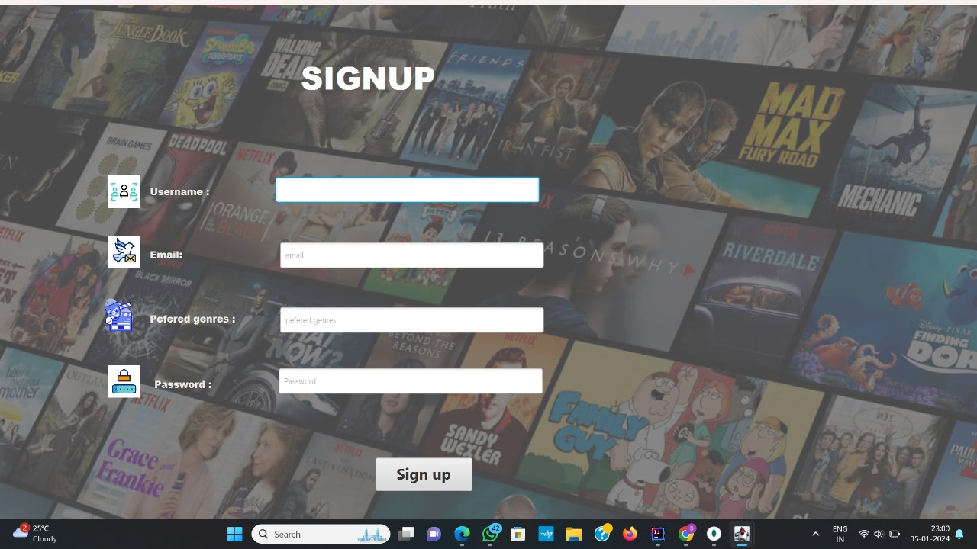
UI DESIGN
SIGN UP/LOGIN

Slide 5
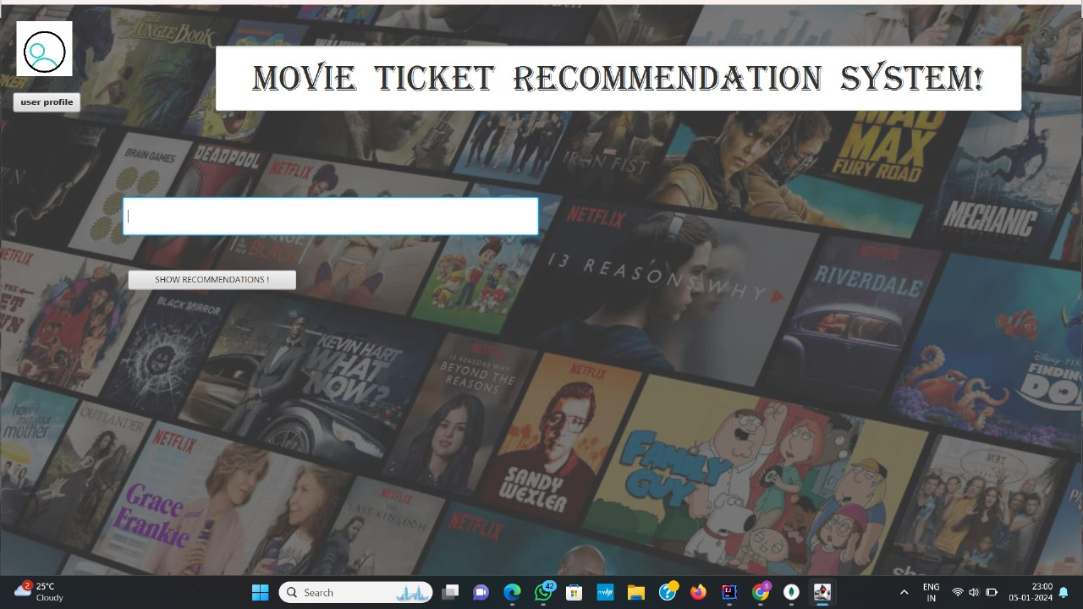
LANDING PAGE
CHOOSE YOUR GENRE

Slide 6
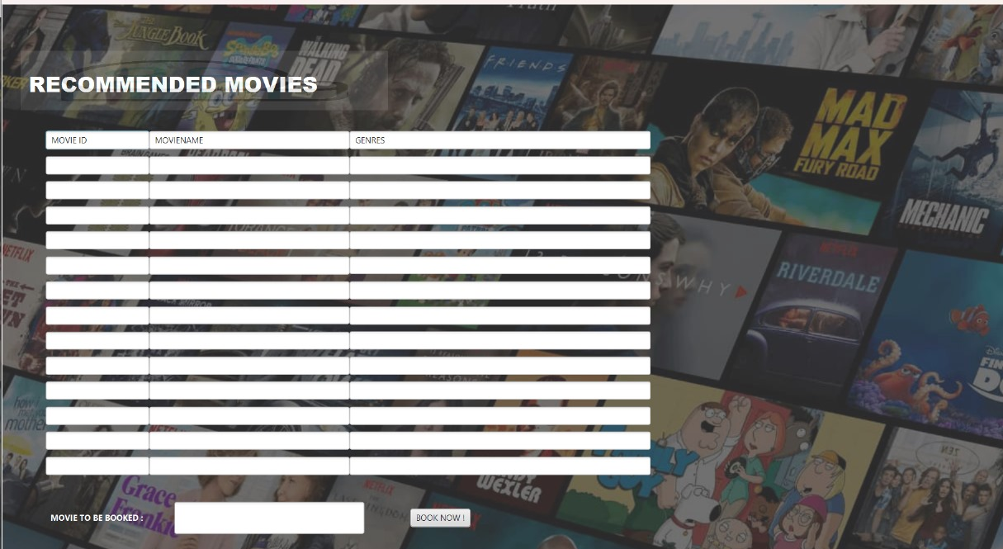

Slide 7
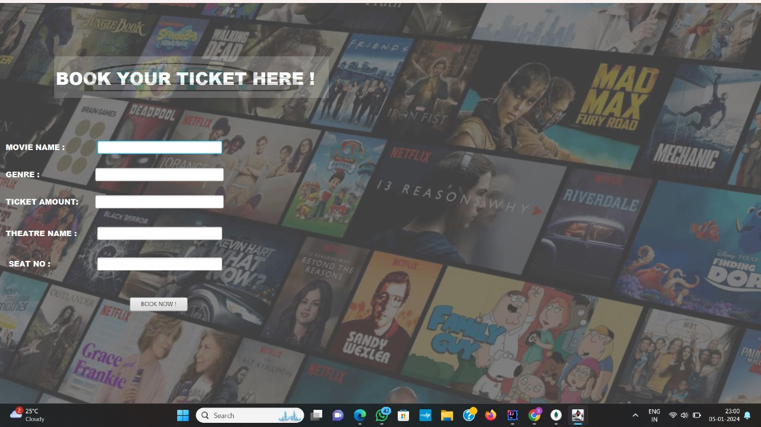
BOOKING
BOOK YOUR TICKETS HERE

Slide 8
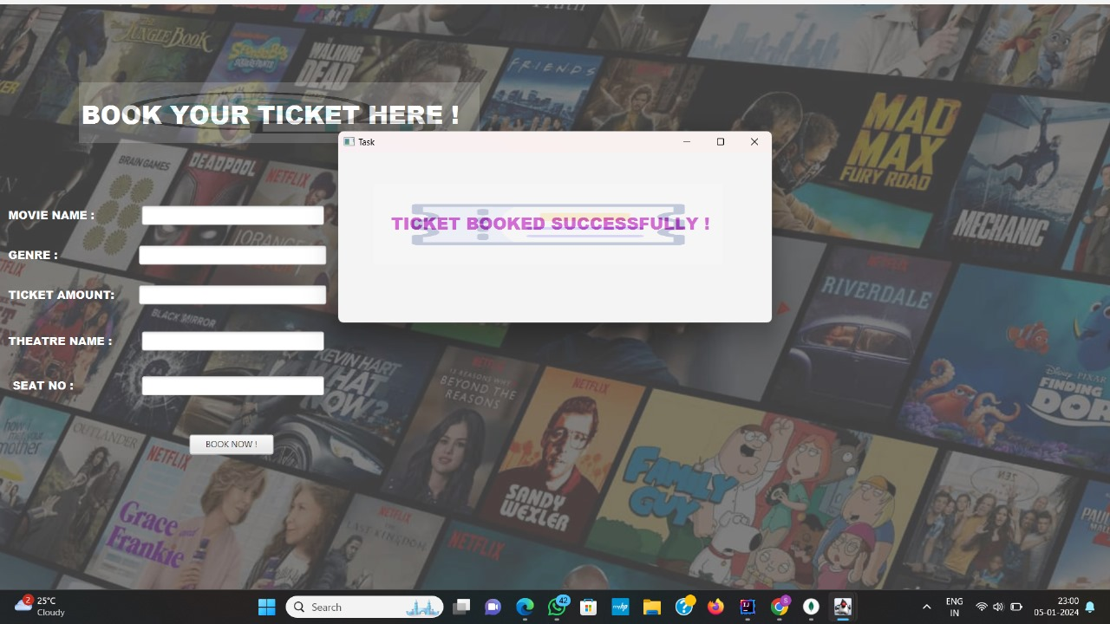
BOOKED SUCCESSFULLY

Slide 9

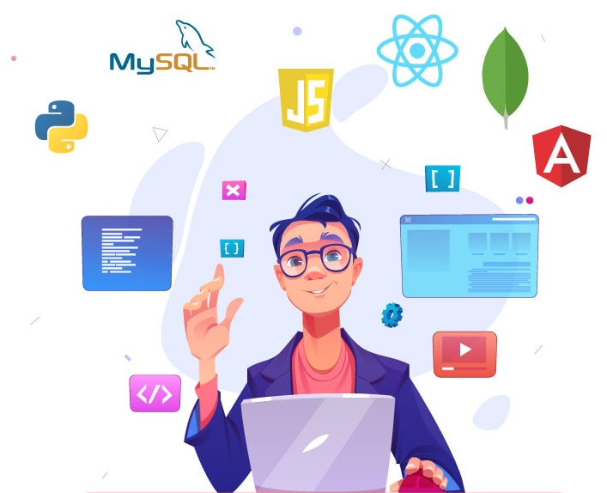


TECHNOLOGIES USED
FRONT END:
SCENE BUILDER
JAVAFX
BACK END:
MONGODB

Slide 10

CONCLUSION
A personalized movie ticket recommendation system can help you choose the best movie to watch based on your preferences. It can help you avoid the hassle of going through a long list of movies and save time. Such a system can be developed using various recommendation algorithms such as content-based, popularity-based, and collaborative filtering¹. By combining these algorithms, a personalized movie ticket recommendation system can be developed that provides recommendations based on your preferences and viewing history. This can help you discover new movies that you might like and make your movie-watching experience more enjoyable.

Slide 11


